Slide 1

The presentation will begin shortly

Slide 2

Webinar 2025

Slide 3
Monash University Accident Research Centre recognises that we are located and conduct business on the unceded lands of the Peoples of the Kulin Nations.
We pay our respects to their Elders, past and present.
Webinar 2025
3

Slide 4

Today’s Moderator
Jerome Carslake
Director of the National Road Safety Partnership Program (NRSPP)
Monash University Accident Research Centre (MUARC)
P: 0429 009 998
E: Jerome.Carslake@monash.edu
Webinar 2025
4

Slide 5






Core Funders
Webinar 2025
5

Slide 6

House Keeping
Presentation 40mins
Q & A Discussion 20mins
Webinar 2025
6

Slide 7

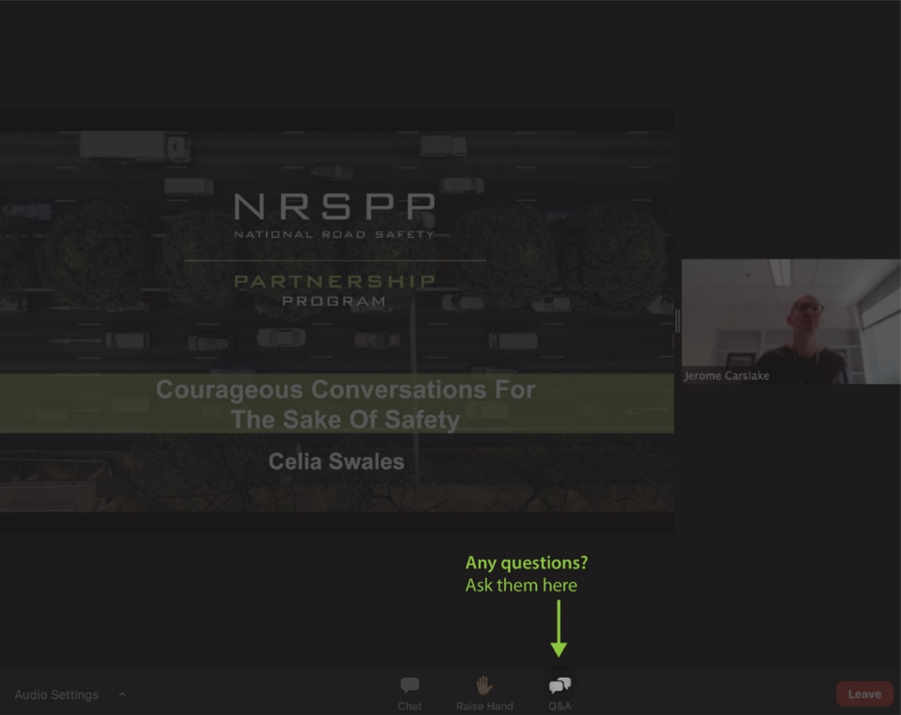
Webinar Functions
Webinar 2025
7

Slide 8

Today’s Presenter
Adam Gibson
Transport Research Manager
NTI seconded to NRSPP for NTARC2.0
Webinar 2025
8

Slide 9

Today’s Presenter
Dr Jasmine Proud
Data Scientist & Researcher
NTARC2.0 / NRSPP / MUARC
Webinar 2025
9

Slide 10
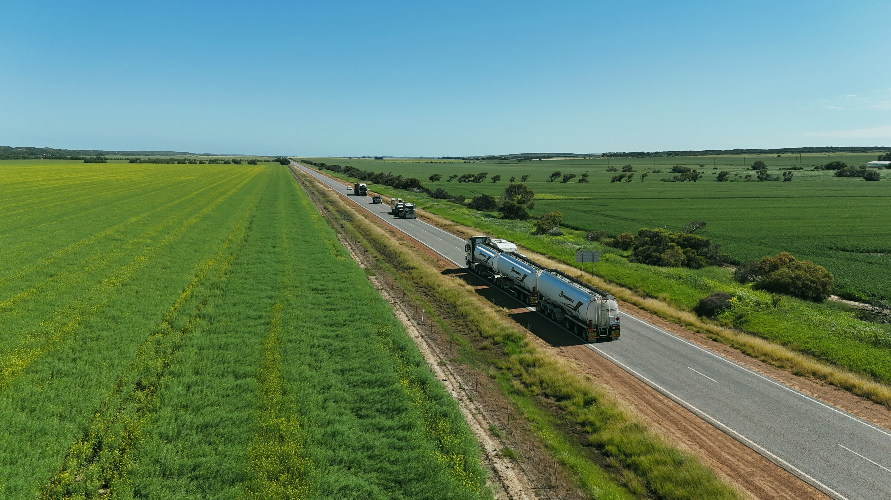
Introduction
Webinar 2025
10

Slide 11
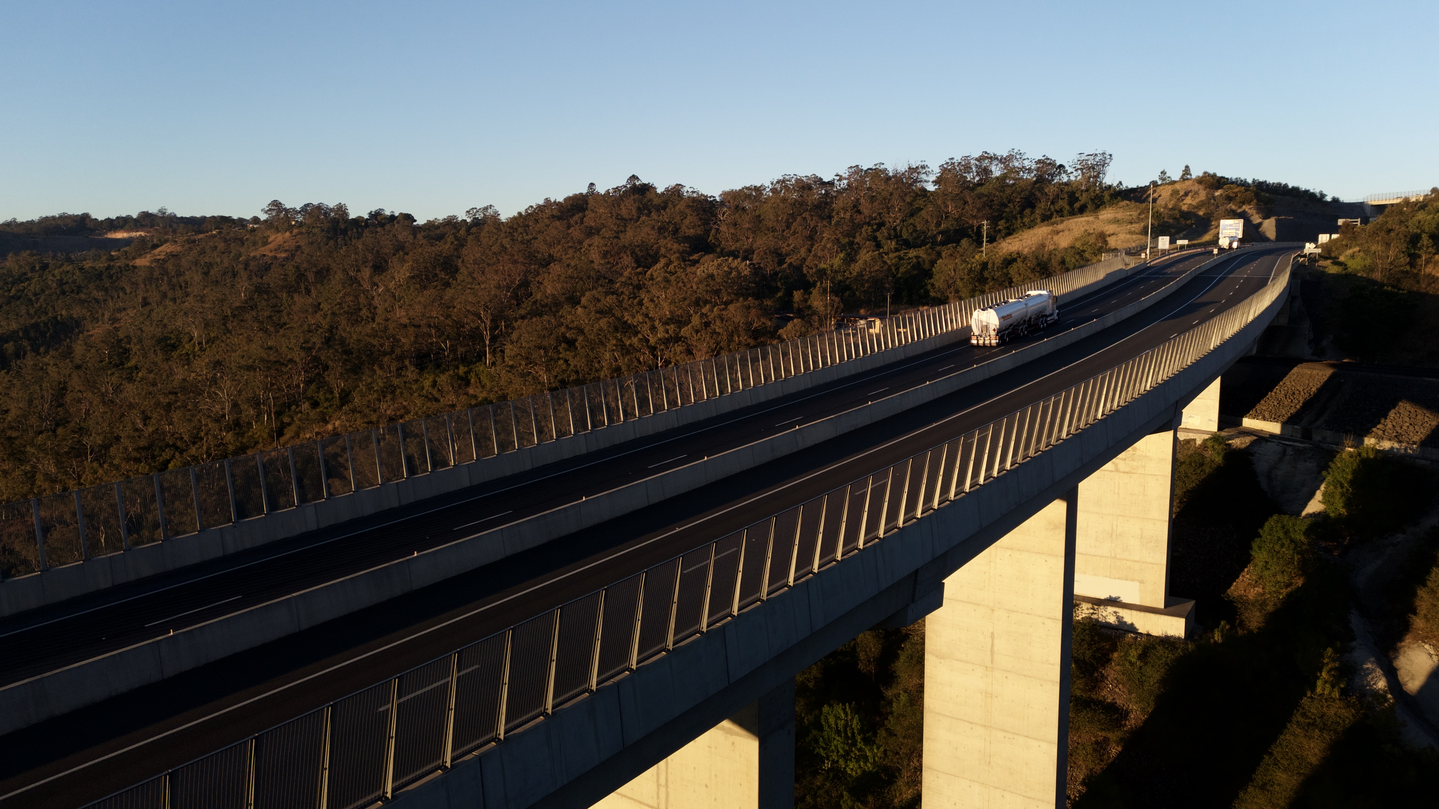
The purpose of this report is not to allocate blame but rather to understand, acknowledge, and proactively improve the key hazards that can be managed in the trucking industry to keep all road users safe.
1. Highlight opportunities
2. Implement measures
3. Inform and influence
4. Share
Reporting with Purpose
Webinar 2025
11

Slide 12
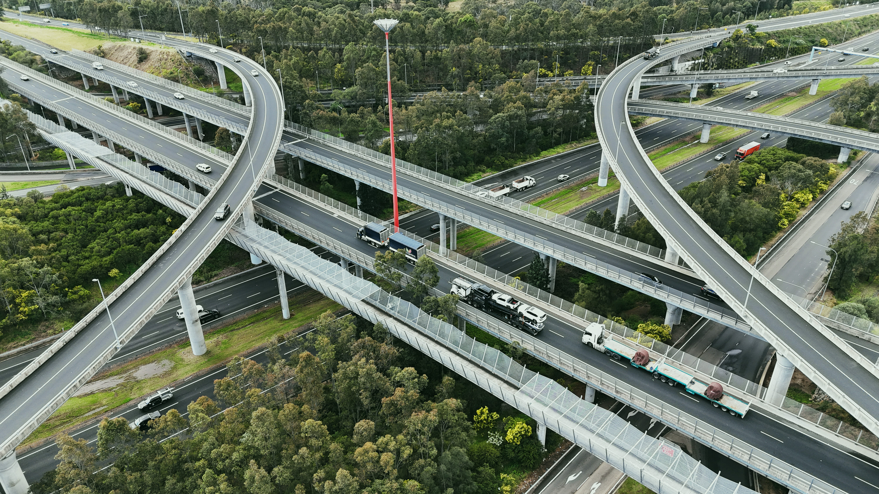
Overview Findings
Webinar 2025
12

Slide 13
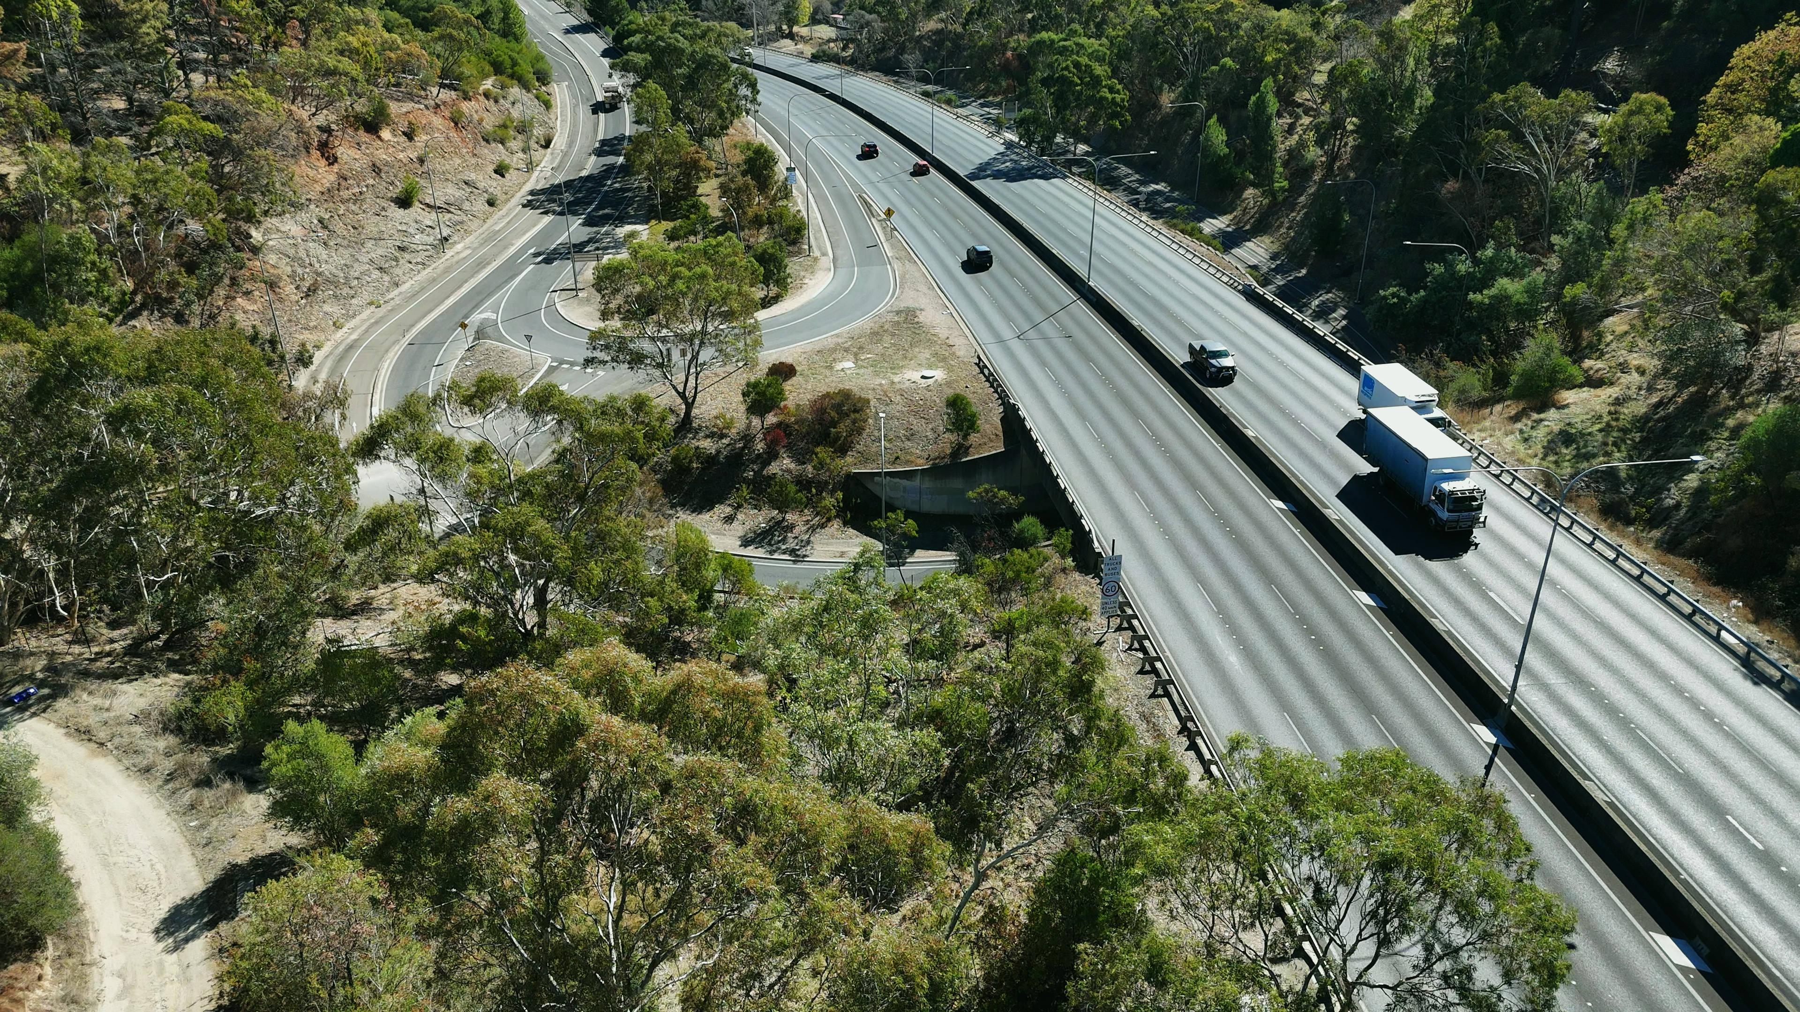
Key Findings
1
Human factor incidents alone accounted for a greater rate than all other cause categories combined in 2024. This reinforces NTARC’s continued focus on addressing human factors through targeted hazard management programs and safety initiatives.
Webinar 2025
13

Slide 14
1634 Major loss claims above $50k in 2023, up from 1282 in 2022.
Webinar 2025
14

Slide 15
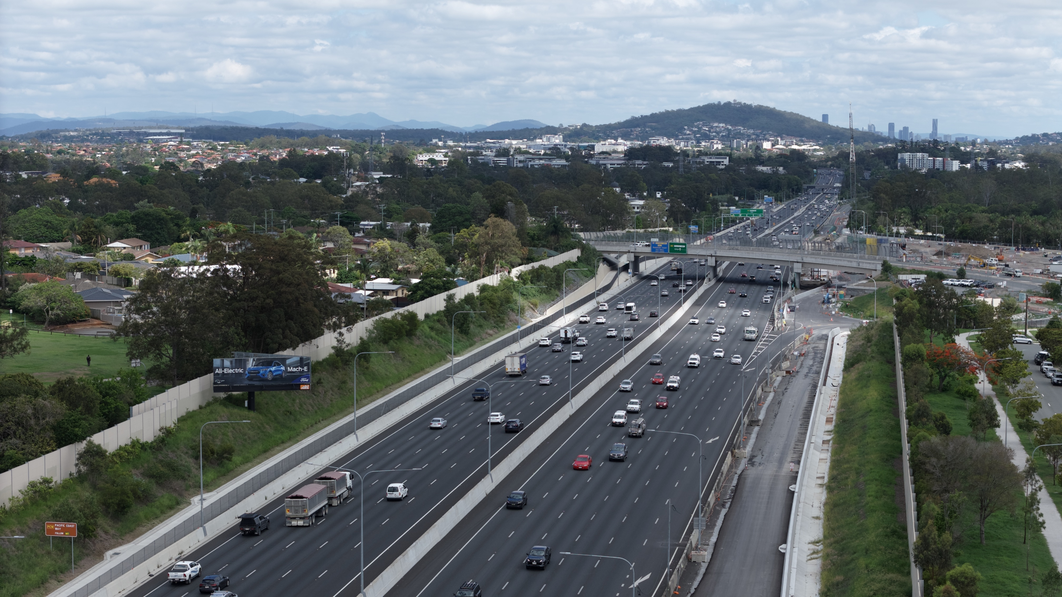
Overview Findings
Webinar 2025
15

Slide 16
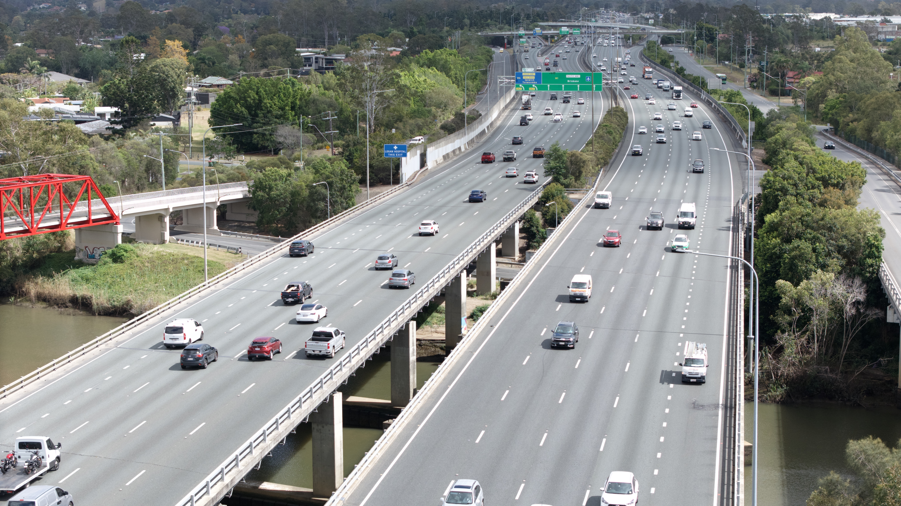
Principle Cause
Webinar 2025
16

Slide 17
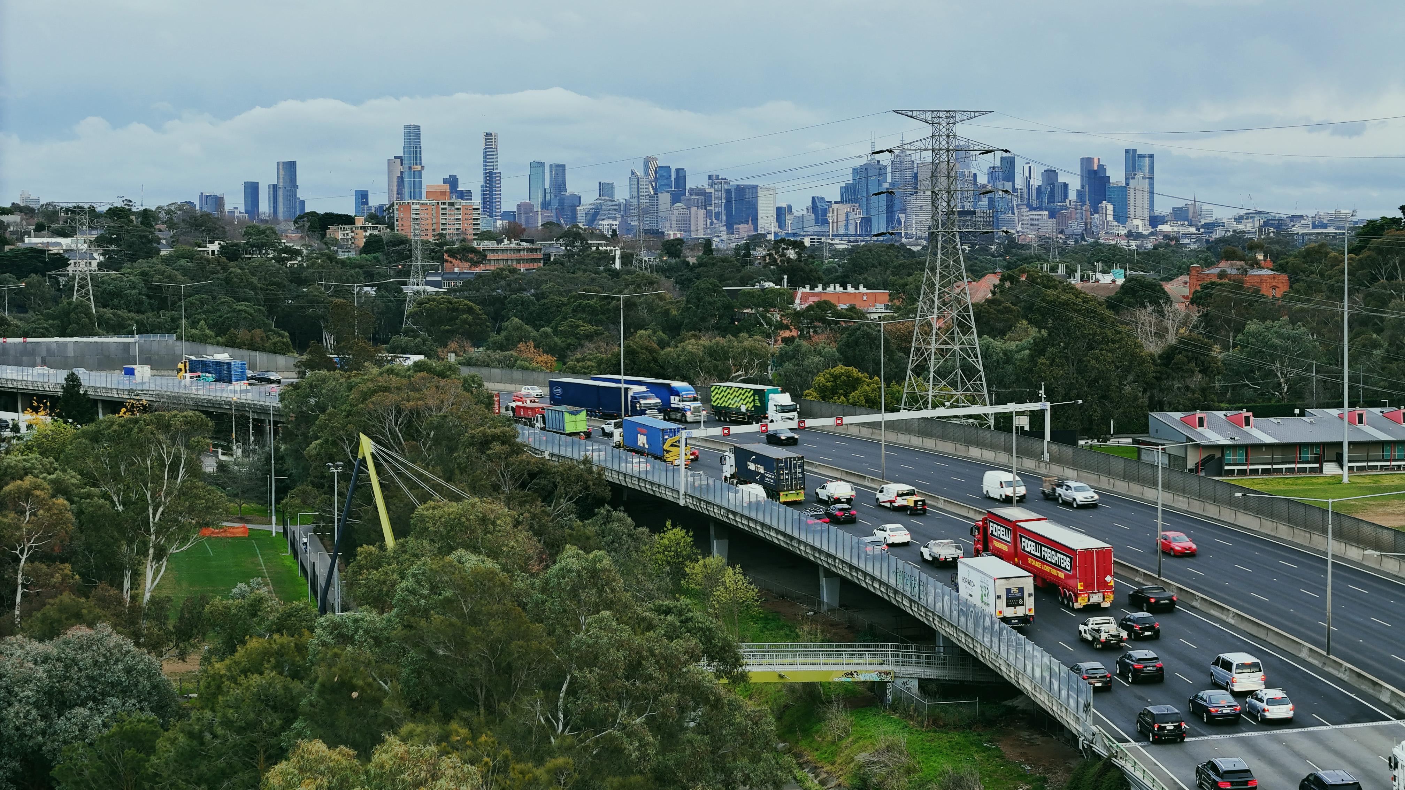
Key Findings
2
Together, the top three sub-causes—Inattention/Distraction, Inadequate Following Distance, and Inappropriate Speed—comprised 60.9% of all human factor crashes.
Webinar 2025
17

Slide 18
Principle
Cause
Webinar 2025
18

Slide 19
42% Major loss claims above $50k in 2023, up from 1282 in 2022.
Webinar 2025
19

Slide 20
Human
Factors
Webinar 2025
20

Slide 21

Questions?
Webinar 2025
21

Slide 22
Inattention/ Distraction

Slide 23
Key Findings
3
Inattention/Distraction has continued an upward trend over recent years and remains the single largest contributor to incident rates within the dataset, representing 17.9% of all crashes in 2024.
Webinar 2025
23

Slide 24
Inattention/ Distraction
Webinar 2025
24

Slide 25
65% Inattention/distraction incidents were single vehicle in 2023.
Webinar 2025
25

Slide 26
32.9%
Inattention/distraction incidents were ‘off path on straight’ in 2023.
Webinar 2025
26

Slide 27
75% Inattention/distraction incidents have increased in 2023 from 2022
Webinar 2025
27

Slide 28
Questions?
Webinar 2025
28

Slide 29
Inappropriate speed
Webinar 2025
29

Slide 30
Key Findings
4
Inadequate Following Distance accounted for 9.2% of all major incidents and remains a growing concern; the rate of increase may be stabilising, offering an opportunity for targeted interventions to curb further growth.
Webinar 2025
30

Slide 31
Inappropriate Speed
Webinar 2025
31

Slide 32
85% Inappropriate speed incidents were ‘off path on curve’ in 2023.
Webinar 2025
32

Slide 33
7.6% Inappropriate speed incidents have increase in 2023 from 2019.
Webinar 2025
33

Slide 34
Questions?
Webinar 2025
34

Slide 35
Inadequate following distance
Webinar 2025
35

Slide 36
Key Findings
5
Inappropriate Speed-related incidents have remained stable in rate, while their proportion of all major incidents declined to 8.6% in 2024, indicating this crash type has not increased in line with overall incident growth.
Webinar 2025
36

Slide 37
Inadequate
Following
distance
Webinar 2025
37

Slide 38
96.3% Inadequate following distance incidents were ‘vehicles from same direction’ in 2023.
Webinar 2025
38

Slide 39
80.2% Inadequate following distance incidents occurred in major cities in 2023.
Webinar 2025
39

Slide 40
74% Inadequate following distance incidents have increased in 2023 from 2019.
Webinar 2025
40

Slide 41
Questions?
Webinar 2025
41

Slide 42
Steering the future
Webinar 2025
42

Slide 43
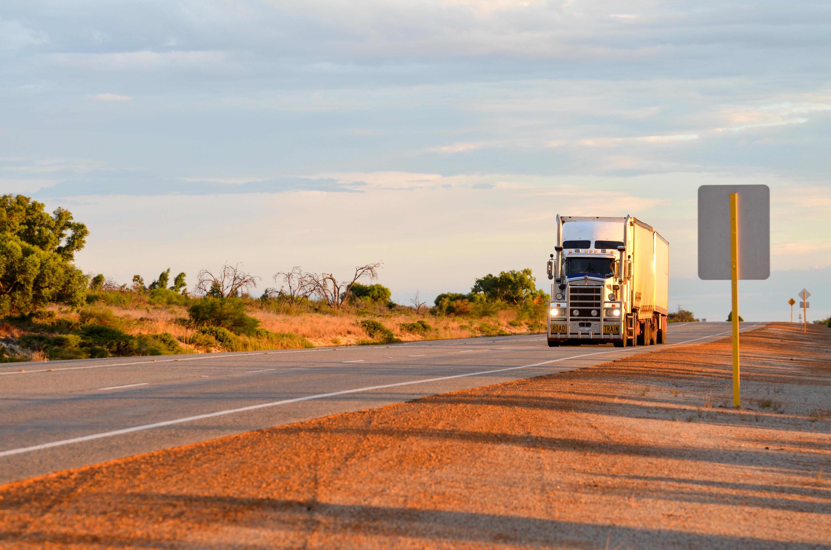
Steering the future
2025 Inclusion Aims
Tie existing published research into NTARC findings
Exposure metrics from external datasets
Link external injury data
Inclusion of expert industry bodies
Geospatial analysis
Figure sample sizes for data subsets
Webinar 2025
43

Slide 44
Injuries
The effect of incidents on wellbeing
Vulnerable road users
Light vehicles
The safe system
Safety technologies
Missing Links
Webinar 2025
44

Slide 45
NTI Key Messages
Webinar 2025
45

Slide 46
Webinar 2025
46

Slide 47
Further Information
Mr Jerome Carslake
National Road Safety Partnership Program
21 Alliance Lane Wellington Road
Monash University Clayton Campus
Victoria 3800 Australia
E: Jerome.carslake@monash.edu
www.nrspp.org.au
Dr Jasmine Proud
Monash University Accident Research Centre
21 Alliance Lane Wellington Road
Monash University Clayton Campus
Victoria 3800 Australia
E: jasmine.proud@monash.edu
www.monash.edu.au/muarc
Mr Adam Gibson
NTI
300 George Street
NTI Brisbane Office
Queensland 4000 Australia
E: adamgibson@nti.com.au
www.nti.com.au
www.nrspp.org.au/ntarc
Webinar 2025
47

