Slide 1


Transform
your fleet safety
Smart tech, safer fleets
AI and telematics for
proactive risk management
Moderated by Jerome Carslake
National Road Safety Partnership Program
23 July 2025

Slide 2
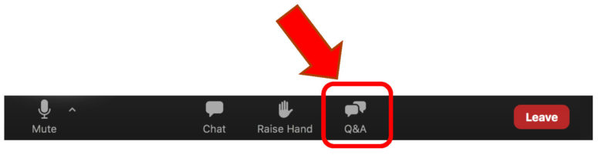
1
Housekeeping
Webinar duration is approx 40 minutes
Question time is 20 minutes
You’ll receive one CIP point for attending today’s session. If you're an ANZIIF member, you can log it via My Account > Add CIP Points on the ANZIIF website or keep your own record.
Functionality – Add your questions here:

Slide 3
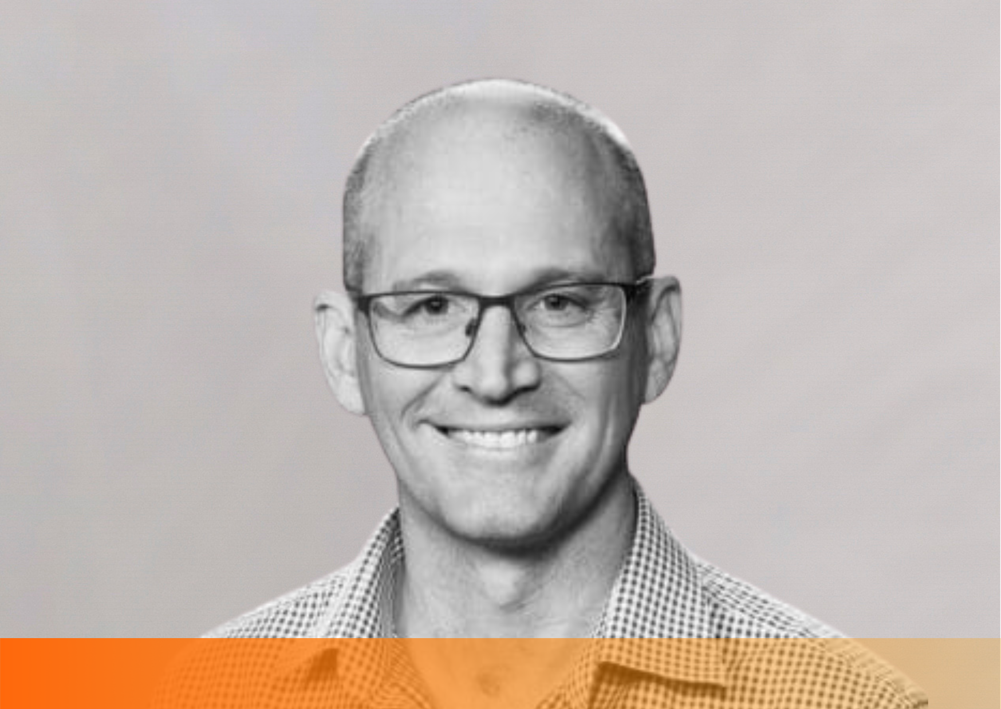

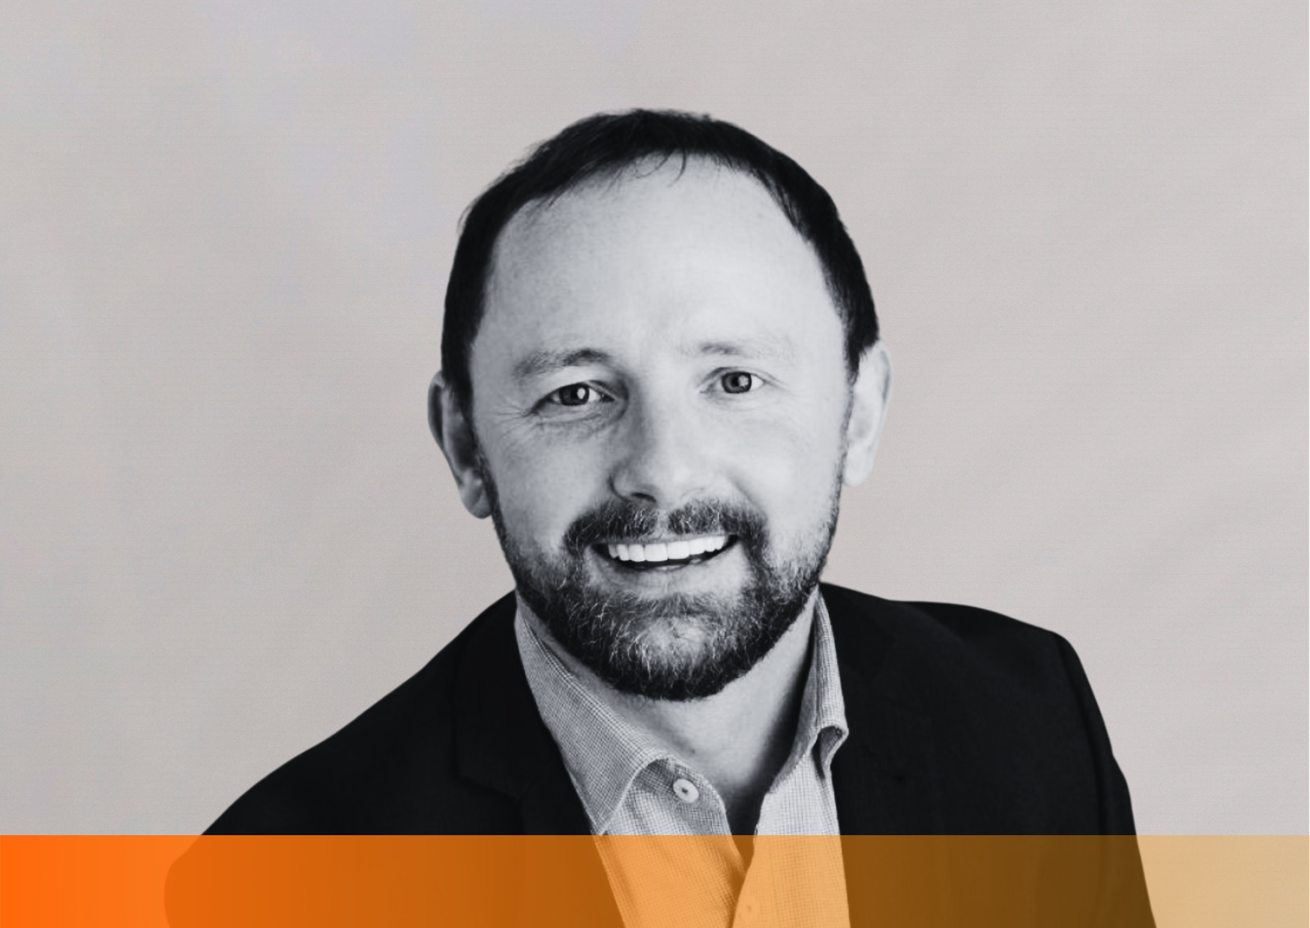
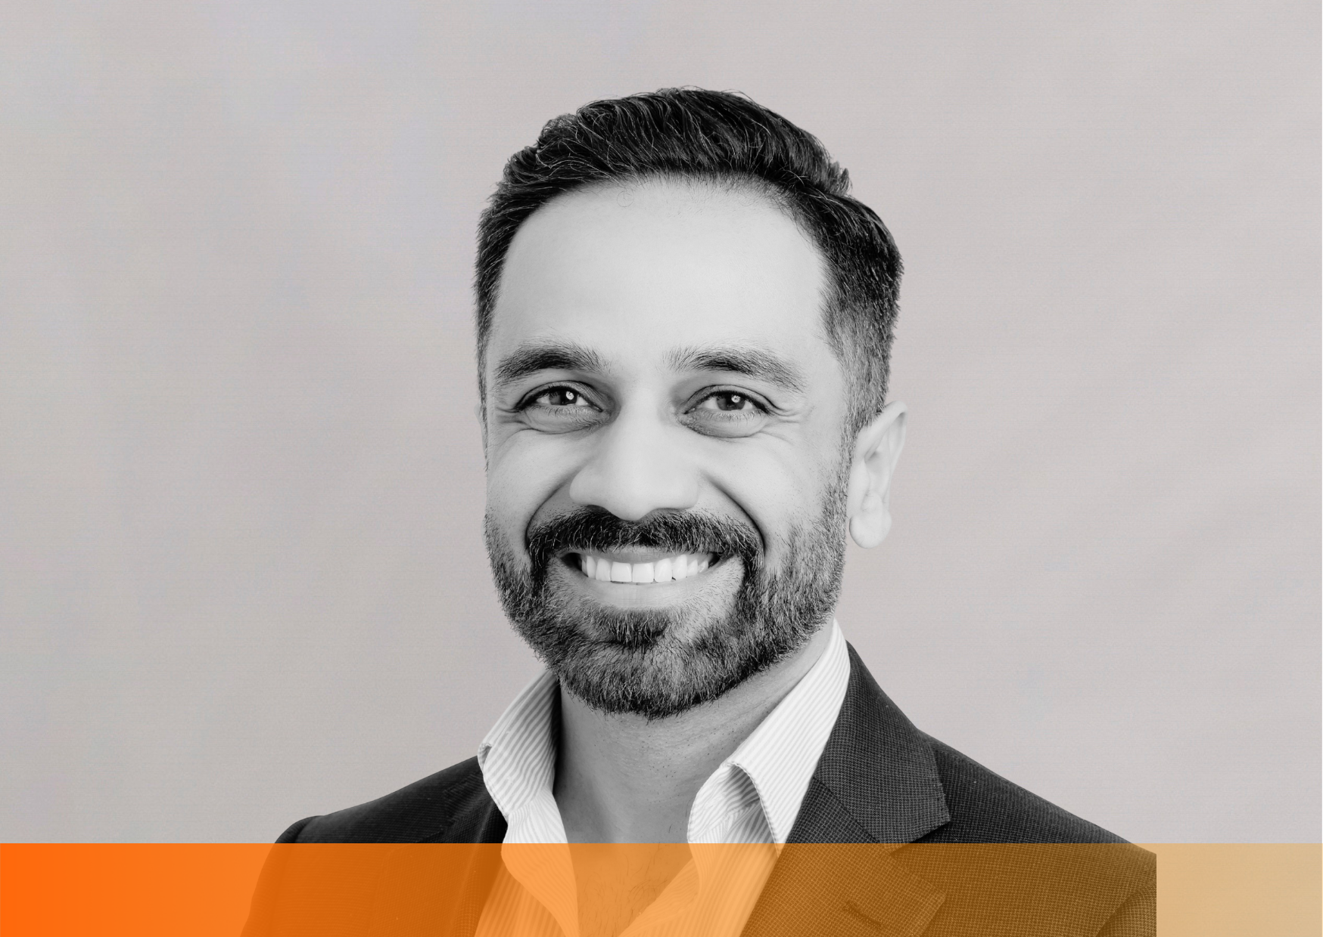
2
Your panel
Moderator
Speakers
Jerome Carslake
Director | National Road Safety Partnership Program
(Monash University)
Johan Forseke
Head of South East Asia
Greater Than
Simon Donovan
Executive, GM Commercial
Fuse Fleet and CRI
Tanwir Dadarkar
Director
Drivetec Solutions

Slide 4

3
Seeing risk
before it
happens

Slide 5

4
From data
to safer
decisions

Slide 6

5
Predictive risk
and insurance
impact

Slide 7

6
Tech that
supports
ESG goals

Slide 8

7
Q&A: Broker conversations
that add value

Slide 9
Transform
your fleet safety
Thank you
for joining
fusefleet.com.au
insurance@fusefleet.com.au
1300 387 338
crinsurance.com.au
insurance@crinsurance.com.au
1300 675 050

