Slide 1

Load Restraint
Using Rated Curtains
24 September 2013
Mike Robertson
MD & Eng Mgr
Phone 0425 001 086
Email :mike.robertson@engistics.com.au
File name: ALC Rated Curtains Training PackREV1.pdf
Images courtesy of Engistics Pty Ltd UNO
:

Slide 2

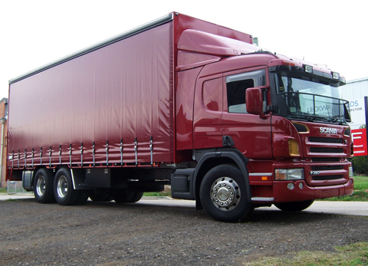
Summary of content
Contents
  Aim of this Pack
  Legal Requirements
  Understanding ratings of curtains
  When are rated curtains NOT suitable?
  Good loads, Mistakes & Solutions
  Multi-layer pallets
  Local delivery truck
  Opening and closing curtains
  Summary
Image from http://www.streamlinetruckbodies.com.au

Slide 3
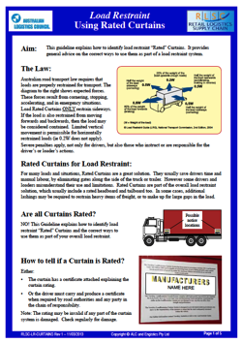
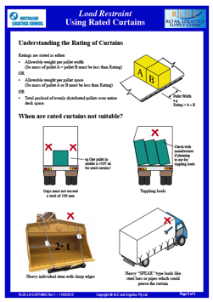
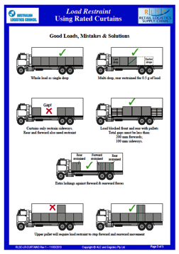
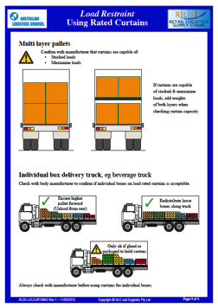
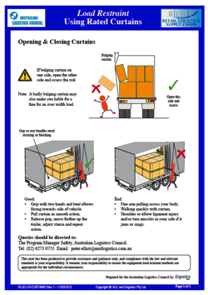
1. Aim of this training pack
The aim of this training pack is to introduce and explain the ALC’s Load Restraint Guideline “Using Rated Curtains”
This pack should be read in conjunction with that guideline.

Slide 4
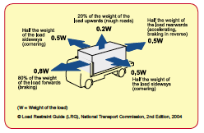


2. Legal Requirements
Load Rated curtains provide sideways restraint to fully blocked loads up to the stated rating
Forward and rearwards restraint must be provided by the headboard & tailboard OR additional lashings
Fully contained loads may accept some limited vertical movement and thus satisfy the exception clause on the vertical 0.2g clause (“except where limited vertical movement is permissible)
Rated Curtains MUST have an engineer’s certificate showing the rating

Slide 5
3. Understanding the Rating of Curtains
^{Ratings are stated as either:}
Allowable weight per pallet width
(So mass of pallet A + pallet B must be less than Rating)
^{OR}
Allowable weight per pallet space
(So mass of pallet A or B must be less than Rating)
^{OR}
Total payload of evenly distributed pallets over entire deck space.
Notes:
This Section 2 is about all the ways loads can fail
No need to go into detail, it is a way to show the many failure modes

Slide 6
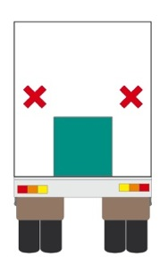
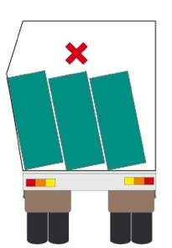
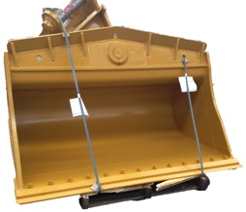

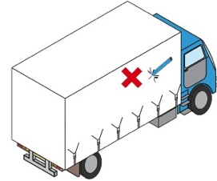
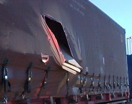
4. When are Rated Curtains Not Suitable?
Gaps must not exceed a total of 100mm
Toppling Loads
Check with manufacturer if planning to use curtains for toppling loads
e.g. One pallet in the middle is NOT okay for rated curtains!
Heavy individual item with sharp edges
Heavy “SPEAR” type loads like steel bars or pipes which could pierce the curtain
2+t

Slide 7
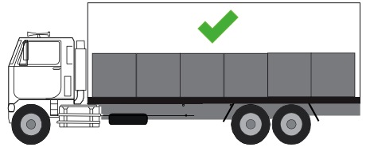
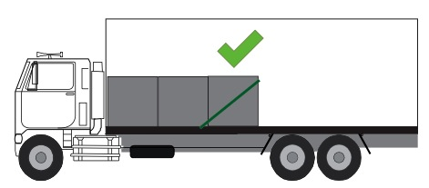
5. Good loads, Mistakes and Solutions
Whole load as single drop
= Ideal for rated curtains
Multi-drop, Ok if the rear is restrained for 0.5g of load

Slide 8
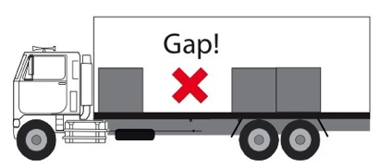
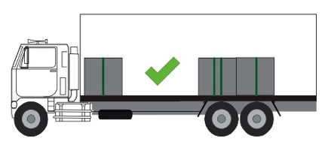
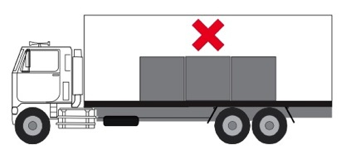
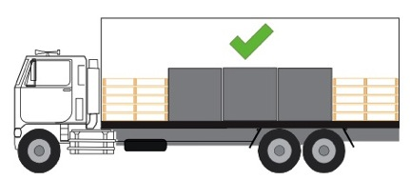
5. Good loads, mistakes and solutions
Curtains only restrain sideways, so forward and rearwards also need restraint
Extra lashings against forward and rearward forces
Load blocked front and rear with pallets
Total gaps must be less than:
200mm forwards
100mm sideways
Notes:
This page IS the law.
Not like other laws like work-place or criminal, with walls full of books on it.
It is simple to UNDERSTAND from one page
Go through the points.
The last point is VERY important.
It’s easy to understand, it looks “simple”, BUT….. The it is NOT always simple to COMPLY
NOTE
Might be value to sketch the view on a sheet of butcher paper
Add the arrow and the G force for each direction as it is covered

Slide 9
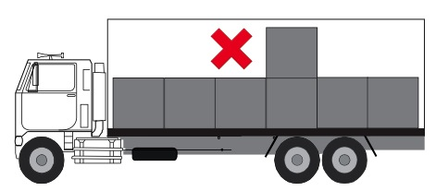
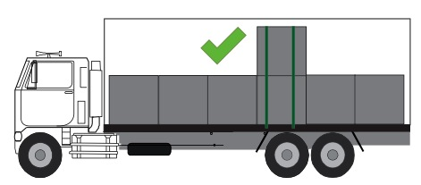
5. Good loads, mistakes and solutions
Upper pallet is not properly restrained
Upper pallet will require load restraint to stop forward and rearward movement

Slide 10
6. Multi-layer pallets
Capacity of curtain for multi-stacked items
If curtains are capable
of stacked & mezzanine loads, add weights of both layers when checking curtain capacity.
m₁
m₂
m₁
m₂
m₃
m₄
m₃
m₄
Total capacity of curtain must be greater than m₁ + m₂ + m₃ + m₄.
Confirm with manufacturers that curtains are capable of:
Stacked loads
Mezzanine loads

Slide 11
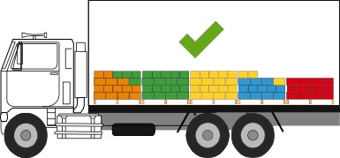
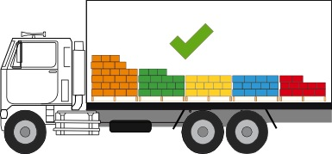
7. Individual box delivery truck
Check with body manufacturer to confirm if individual boxes on load rated curtains is acceptable.
Redistribute loose boxes along truck
Ensure higher pallet forwards (unload from rear).
Always check with manufacturer before using curtains for individual boxes
Only okay if glued or packaged to hold cartons

Slide 12
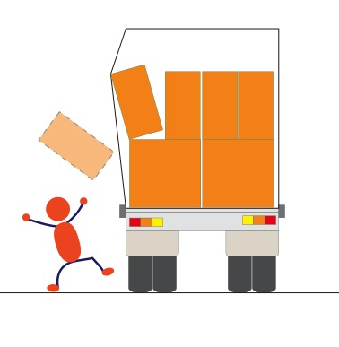


8. Manual Handling Risk
If bulging curtain on one side, open the other side and assess the risk.
Note: A badly bulging curtain may also make you liable for a fine for an over width load.
Open this side and assess.

Slide 13
8. Opening and closing curtains
✓
✗
Gap so rear bundles need securing or blocking
Good:
Grip with two hands and bent elbows facing towards side of vehicle.
Pull curtain in smooth action.
Release grip, move further up the trailer, adjust stance and repeat action.
Bad:
One arm pulling across your body.
Walking quickly with curtain.
Shoulder or elbow ligament injury and/or torn muscles in your side, if it jams or snags.

Slide 14
Summary
First Check for certificate and its Rating
Ensure the maximum mass of cargo behind the Load Rated Curtain is less than the rated capacity
Check that the cargo is restrained for Forwards and Rearwards forces as well as sideways
Avoid gaps between cargo across the vehicle bed
Do not use Curtains for the restraint of large objects with sharp edges
Follow Manufacturer’s advice on individual cartons or mezzanine decks
Use correct manual handling techniques when opening / closing
Be aware of the potential for loose objects when opening curtains
Queries may be directed to:
The Program Manager Safety, Australian Logistics Council. Tel: (02) 6273 0755 Email: peter.elliot@austlogistics.com.au
This presentation has been produced to provide assistance and guidance only, and compliance with the law and relevant standards is your responsibility. It remains your responsibility to ensure the equipment load restraint methods are appropriate for the individual circumstances.

